Slide 1

Recommendation System with Machine Learning & Deep Learning - Phrase 2
Kam Hin Ho

Slide 2
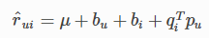
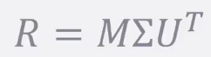
Singular Value Decomposition (SVD)
SVD runs principal component analysis (PCA) on both the users and the items and giving us back that the matrices we need.
It is known to produce a very accurate result, and it was used in the Netflix prize competition.
R: All ratings for a set of users
M: Measures of each movie that considered in the movie genres lines
U: Measures of each person’s interest in the movie genres
Notes:
PCA - identifies the latent features and describe each individual movies as some combination of them
Matrix R can be factored into smaller matrices that describe general categories of users and items that can be multiplied together. → SVD
Once we have the factored in matrices, we can predict the rating of any item by any user by taking a dot product from each matrix.
U: the columns describe typical users for each latent feature we produced
Pu The user factors
Qi The item factors (only exists if fit() has been called) Bu The user biases (only exists if fit() has been called) Bi The item biases (only exists if fit() has been called)

Slide 3
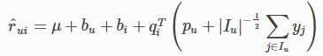
SVD++
SVD++ is an extension of SVD taking into account implicit ratings
An implicit rating describes the fact that a user u rated an item j, regardless of the rating value.
yj terms are a new set of item factors that capture implicit ratings.
SVD++ abstract each user with a factors vector
SVD++ has a lower RMSE than SVD
(SVD)
(SVD++)
Notes:
Pu The user factors
Qi The item factors (only exists if fit() has been called) Bu The user biases (only exists if fit() has been called) Bi The item biases (only exists if fit() has been called) Yj The (implicit) item factors

Slide 4
Limitation of SVD
Each user and item is essentially projected onto a latent space, represented by a latent vector.
The more similar the two latent vectors are, the more related the corresponding users’ preference.
We can measure the similarity of any two latent vectors with cosine-similarity or dot product.
However, the dot product limits the expressiveness of user and item latent vectors.

Slide 5
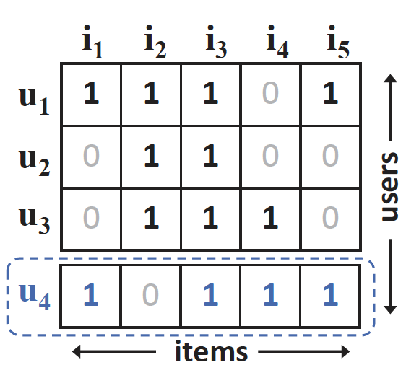
Limitation of SVD Cont.

Slide 6
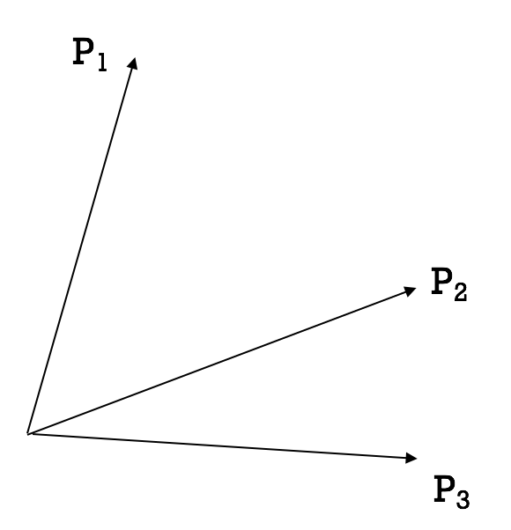
Limitation of SVD Cont.
S{x,y} denotes the similarity between user x and user y
By computing the cosine-similarity between users 1, 2, and 3, we know that S{2, 3} > S{1, 2} > S{1, 3}.
Without loss of generality, we map the users onto a latent space of two dimensions as the following.

Slide 7
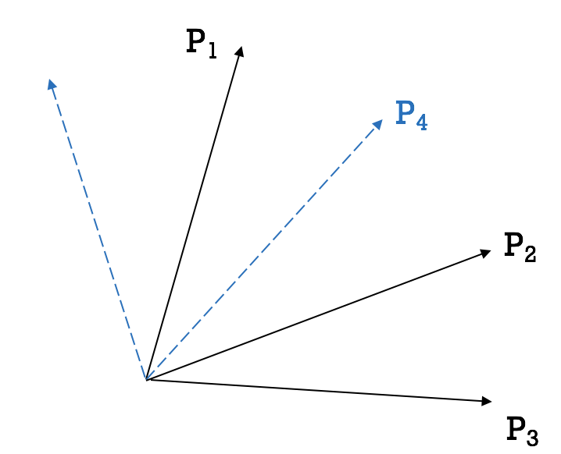
Limitation of SVD Cont.
Comparing the similarity with the others,
we obtain S{1,4} > S{3,4} > S{2,4}
However, no matter we place the latent vector P4 to the right or left of P1, it will inevitably be closer to P2 than P3.

Slide 8
Neural Collaborative Filtering (NCF)
It replaces the user-item inner product with a neural architecture
NCF tries to express and generalize matrix factorization (MF) under its framework
NCF tries to learn User-item interactions through a multi-layer perceptron (MLP).
An upgrade over MF as MLP that can learn any continuous function and has high level of nonlinearities making it well endowed to learn user-item interaction function.

Slide 9
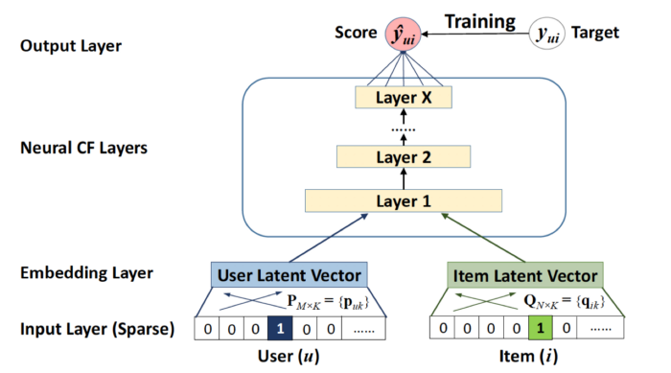
Neural Collaborative Filtering (NCF)
User and item are one-hot encoded in input Layer
User and Item are mapped to the hidden space with embedding layers accordingly.
In Neural CF layer, it can be any kind neuron connections, such as multiple layer perceptron.
NCF predicts the rating

Slide 10
References
https://people.engr.tamu.edu/huangrh/Spring16/papers_course/matrix_factorization.pdf
https://towardsdatascience.com/paper-review-neural-collaborative-filtering-explanation-implementation-ea3e031b7f96#:~:text=Neural%20Collaborative%20Filtering%20(NCF)%20is,to%20build%20a%20recommender%20system.
https://towardsdatascience.com/neural-collaborative-filtering-96cef1009401

